Slide 1
Empirical Study
Monte Carlo Study

Slide 2
Empirical Study
Monte Carlo Study
Underlying Process
Observed Data
Statistical Model

Slide 3

Empirical Study
Monte Carlo Study
Underlying Process
Observed Data
Statistical Model

Slide 4
Empirical Study
Monte Carlo Study
Underlying Process
Observed Data
Statistical Model

Slide 5
Empirical Study
Monte Carlo Study
Underlying Process
Observed Data
Statistical Model
fit (
model = consensus_emergence_model
data = df.csv
)

Slide 6
Empirical Study
Monte Carlo Study
Underlying Process
Observed Data
Parameter Estimates
Statistical Model
fit (
model = consensus_emergence_model
data = df.csv
)

Slide 7
Empirical Study
Monte Carlo Study
Underlying Process
Parameters (Unknown)
?
Observed Data
Parameter Estimates
Statistical Model
fit (
model = consensus_emergence_model
data = df.csv
)

Slide 8
Empirical Study
Monte Carlo Study
Underlying Process
Parameters (Unknown)
?
Observed Data
Parameter Estimates
Statistical Model
fit (
model = consensus_emergence_model
data = df.csv
)

Slide 9
Empirical Study
Monte Carlo Study
Underlying Process
Parameters (Unknown)
Parameters (Known)
?
Observed Data
Parameter Estimates
Statistical Model
fit (
model = consensus_emergence_model
data = df.csv
)

Slide 10
Empirical Study
Monte Carlo Study
Underlying Process
Parameters (Unknown)
Parameters (Known)
?
Observed Data
Parameter Estimates
Statistical Model
fit (
model = consensus_emergence_model
data = df.csv
)

Slide 11
Empirical Study
Monte Carlo Study
Underlying Process
Parameters (Unknown)
Parameters (Known)
?
Observed Data
Parameter Estimates
Statistical Model
fit (
model = consensus_emergence_model
data = df.csv
)
fit (
model = consensus_emergence_model
data = df.csv
)

Slide 12
Empirical Study
Monte Carlo Study
Underlying Process
Parameters (Unknown)
Parameters (Known)
?
Observed Data
Parameter Estimates
Parameter Estimates
Statistical Model
fit (
model = consensus_emergence_model
data = df.csv
)
fit (
model = consensus_emergence_model
data = df.csv
)

Slide 13
Empirical Study
Monte Carlo Study
Underlying Process
Parameters (Unknown)
Parameters (Known)
?
Compare
Observed Data
Parameter Estimates
Parameter Estimates
Statistical Model
fit (
model = consensus_emergence_model
data = df.csv
)
fit (
model = consensus_emergence_model
data = df.csv
)

Slide 14
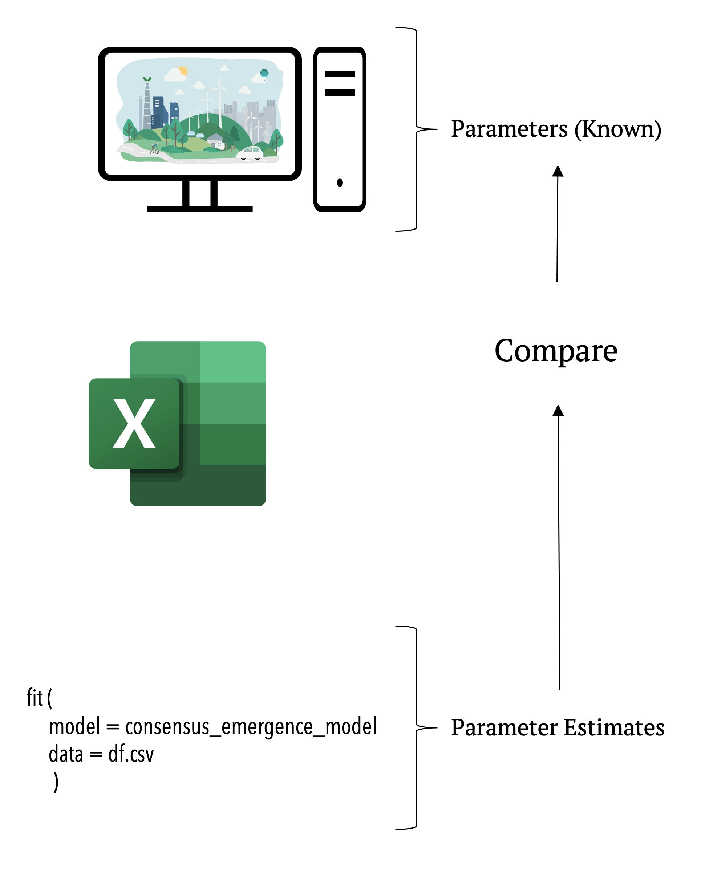
Empirical Study
Monte Carlo Study
Underlying Process
Parameters (Unknown)
?
Repeat n times
Observed Data
Parameter Estimates
fit (
model = consensus_emergence_model
data = df.csv
)
Statistical Model
fit (
model = consensus_emergence_model
data = df.csv
)

